Slide 1
Interim Results Presentation
15 August 2012

Slide 2
Agenda
Key Events
Operations
2012 Interim Results
Outlook
Questions & Answers

Slide 3
Key Events
3

Slide 4
Key Events
Robust recurring pre-tax profit of £9.2m, up 5% from H1 2011
EPRA NAV of £0.60 pence compared to £0.63 pence at 30 December 2011
Resilient operating performance of UK shopping centres underpinned by footfall outperforming the national index by 2.6% and broadly stable occupancy year on year
Progress in execution of strategy to focus on UK dominant community shopping centres:
  Sale of The Mall Norwich for £77.3 million in July 2012 combined with acquisition of 20% interest in the Kingfisher Shopping Centre in Redditch
  Mall debt reduced to £570.9 million, with an LTV of 67% and a net debt to property value of 53%
  Purchase of additional units in The Mall taking the Group’s share to 20.15%
  Restructuring of Thurrock interest facilitates further realisation of value from The Junction fund following capital distributions of £15.5m in prior years
See-through net debt to property value down to 63% (2011: 65%); UK fund see-through net debt to property value flat at 54%

Slide 5
Operations
5

Slide 6
NAV Constituents at 30 June 2012
 | Property assets (£m) | Debt & other liabilities (£m) | NAV (£m) | % of NAV (%) | NIY (%) | Net debt to property value (%)
The Mall | 197.9 | (130.2) | 67.7 | 36.4% | 6.9% | 57%
Kingfisher Redditch | 26.4 | (17.2) | 9.2 | 4.9% | 8.0% | 60%
Waterside Lincoln | 13.1 | (6.3) | 6.8 | 3.7% | 7.3% | 44%
Shopping centres | 237.4 | (153.7) | 83.7 | 45.0% | 7.1% | 57%
Retail parks – The Junction | 36.4 | (19.9) | 16.5 | 8.9% | 5.6% | 51%
X-Leisure | 67.7 | (35.7) | 32.0 | 17.2% | 6.5% | 48%
Great Northern | 71.3 | (61.9) | 9.4 | 5.1% | 8.3% | 80%
Hemel Hempstead | 8.4 | (4.1) | 4.3 | 2.3% | - | 50%
Xscape Braehead | 24.1 | (19.6) | 4.5 | 2.4% | 6.7% | 79%
Leisure | 171.5 | (121.3) | 50.2 | 27.0% | 6.7% | 66%
Germany | 168.1 | (124.2) | 43.9 | 23.6% | 6.6% | 72%
Other net assets | 0.2 | (8.5) | (8.3) | (4.5)% | - | -
Net assets | 613.6 | (427.6) | 186.0 | 100.0% | - | 63%

Slide 7
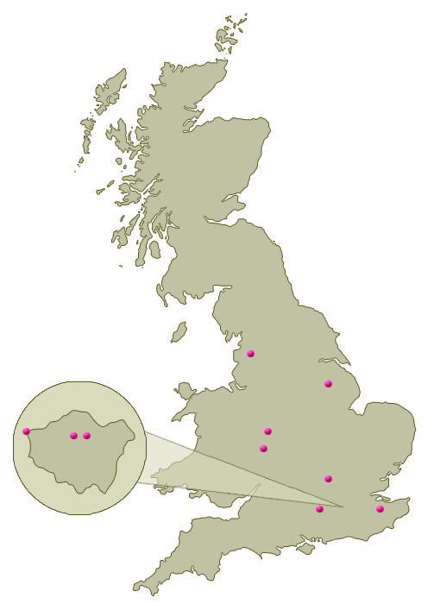
Shopping Centres - Overview
£1 billion property portfolio
66% of shopping centres in London and SE England
10 town centre locations
Majority of locations dominant in the local community
Affordable rents - average rent per sq ft of £20 (zone A: £25-£145)
Commercial income in 2012 forecast at £3.9m (+2% 2011)
Ownership of car parking and good public transport facilities
Management platform facilitates rapid adaption to changing patterns of consumer behaviour

Slide 8
Shopping Centres – Regional Profile
 | Valuation |  |  | Net initial yield
 | 30 June 12 | Movement vs. Dec 11 |  | 30 June 12 | Movement vs. Dec 11
 | £m | % |  | % | %
Greater London | 336 | 4% |  | 6.4% | (0.4)%
South East | 331 | (5)% |  | 6.9% | 0.0%
Regions | 348 | (6)% |  | 7.7% | 0.2%
Total shopping centres | 1,015 | (3)% |  | 7.0% | (0.1)%
Excluding The Mall Norwich which was sold in July 2012

Slide 9
Shopping Centres – Operating Performance
Footfall outperformed the national index by 2.6% a decline of 1.8% for the first seven months compared to a 4.4% decline in the national index
34 new lettings at 1.5% below ERV
10 lease renewals at 0.2% above ERV
37 rent reviews completed at 7.0% above ERV
Occupancy 94.6% at 30 June 2012, stable year on year
Passing rent down 1.8% year on year
Information above excluding The Mall Norwich which was sold in July 2012
9

Slide 10
Shopping Centres – Administrations
49 units put into administration during H1, 2012 with passing rent of £4.8 million
Strategy to maintain occupancy and trading vibrancy
23 re-let or assigned with a rent reduction of £0.9 million
8 still open and trading
12 under offer or held for asset management initiatives
Leaving only six units that have yet to be re-let
Of the 94.6% occupancy, 1.0% of relates to units that are in administration but are still open and trading
Information above excluding The Mall Norwich which was sold in July 2012
10

Slide 11


















Shopping Centres – Asset Management
Positive new lettings and detailed negotiations ongoing with the following tenants:
11

Slide 12
Shopping Centres – Asset Management
Waterside Lincoln
Further upgrade to tenant mix with introduction of Office Shoes on a new 10 year letting without break at ERV
Strategy to improve scheme expiry profile making progress:
  Terms agreed with three national retailers to either regear or relocate within the scheme
  New letting to Office Shoes on key entrance unit
Reconfiguration gaining momentum:
  Settled scheme design
  Terms agreed with Next for 14,000 sq ft two level unit
  Terms agreed with catering operator for newly created Riverside unit
  Advanced negotiations with second national fashion anchor for 23,000 sq ft unit
  Projected site start during H1 2013
12

Slide 13
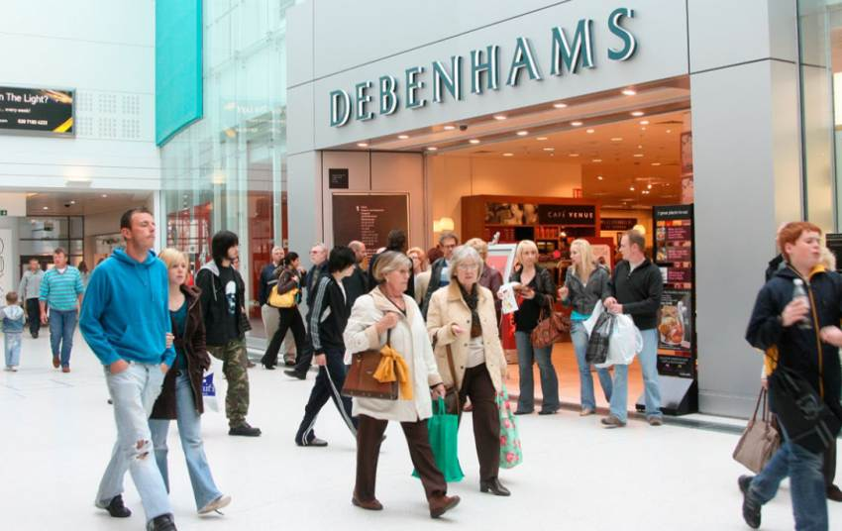
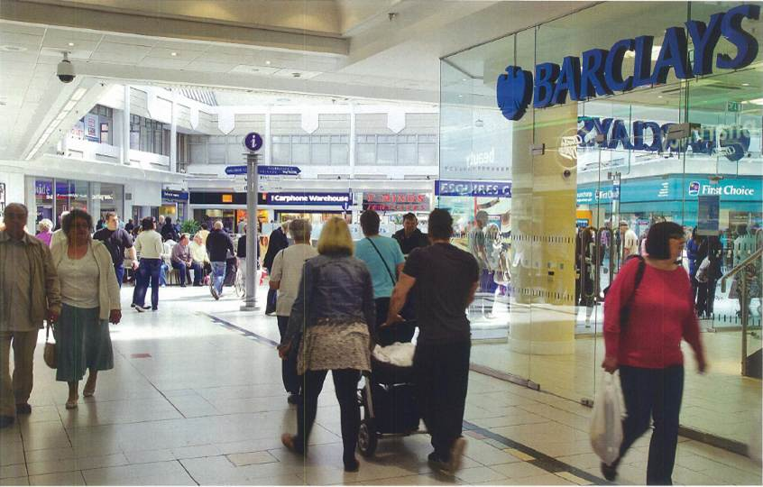
Shopping Centres – Asset Management
Kingfisher Redditch
920,000 sq ft retail scheme acquired May 2012 for £130m at a 8.0% NIY
Business plan is to grow Zone A rents from £65 / £75 per sq ft through rebalancing tenant mix (leisure and fashion operators). Initiatives include:
Subdivide former TJ Hughes units and let to 4 restaurants adjacent to existing cinema – in progress with good initial A3 demand
Enhance fashion mix around central Mall, Evesham Walk – in progress with new vision created for “The Walk”
Introduction of food store to the shopping centre – optimal site for store being considered to meet occupier demand
Improve net income through driving operating efficiencies and improving ancillary income
13

Slide 14
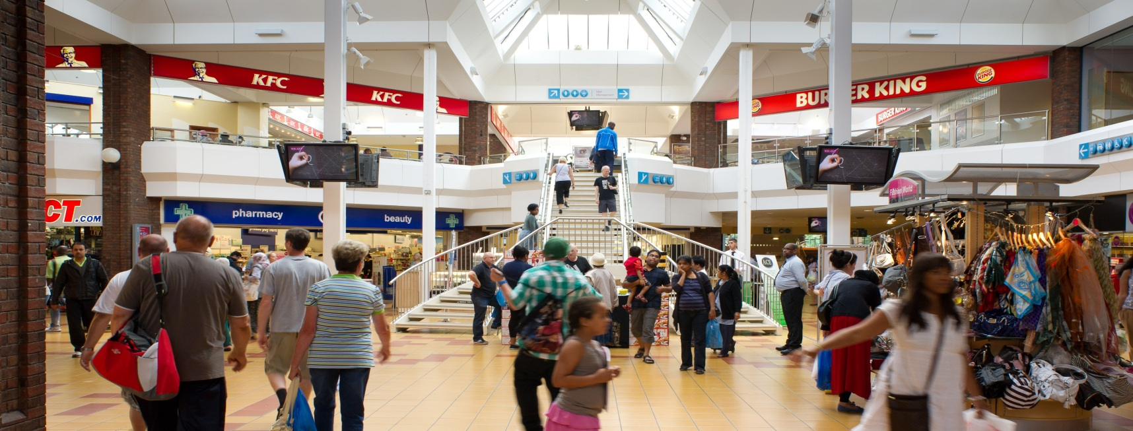
Shopping Centres – Asset Management
The Mall Walthamstow
260,000 sq ft London Mall with strategic plan to drive rental growth through improved retail offer
Proposed 65,000 sq ft extension incorporated into the Area Action Plan consultation document
Terms agreed with retailers to occupy 50% of space
Heads of Terms on local authority development agreement in place
14

Slide 15
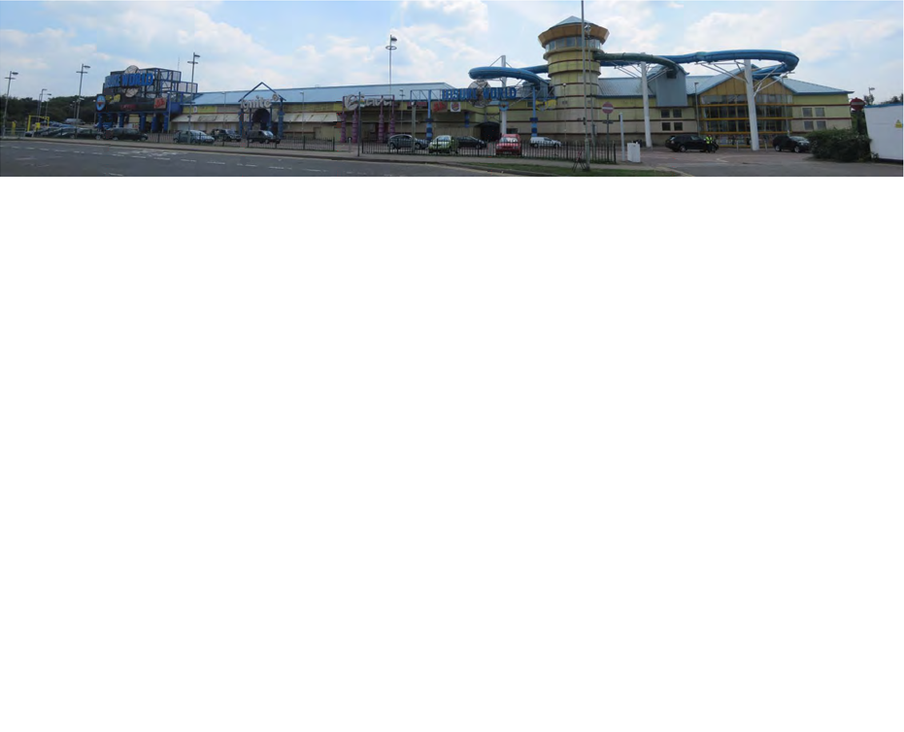
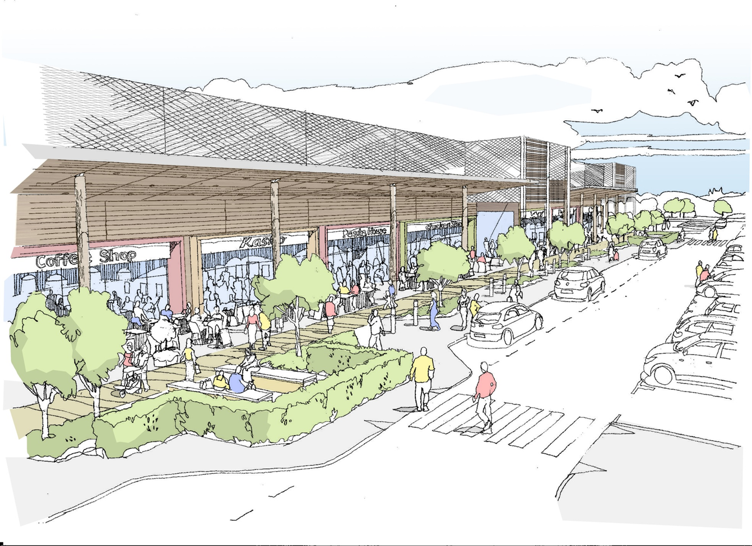
Hemel Hempstead – Asset Management
Planning consent obtained 13 March 2012
Re-development and re-branding of the 160,000 sq ft scheme
Replacement of swimming complex and nightclubs with family dining, adventure play areas and first floor gym, with the ice rink to be retained
Significant letting progress made:
  Terms agreed on 5 of the 8 restaurant units
  Terms agreed with Dacorum Sports Trust for the gym, adventure play area and the ice rink
Options for the remaining space include ten-pin bowling, bingo and family based activities
15

Slide 16
German Valuations
 | Valuation | Valuation | Valuation | NIY | NIY
 | 30 June 2012 | 30 December 2011 | movement | 30 June 2012 | 30 December 2011
Portfolio | €million | €million | €million | % | %
1 | 54.3 | 55.3 | (1.0) | 6.9 | 6.8
2 | 92.2 | 92.7 | (0.5) | 6.3 | 6.3
3 | 143.6 | 144.3 | (0.7) | 6.4 | 6.4
5 | 56.7 | 58.3 | (1.6) | 6.8 | 6.8
6 | 70.5 | 67.3 | 3.2 | 7.0 | 7.0
 | 417.3 | 417.9 | (0.6) | 6.6 | 6.6
4 | 154.5 | 176.0 | (21.5) | 8.4 | 6.7
Total | 571.8 | 593.9 | (22.1) | 7.1 | 6.6
16

Slide 17
German Portfolio Comparison
The German joint venture comprises six separate portfolios
There are significant differences between portfolio 4 and the other five portfolios which are stronger due to the following key factors:
Longer weighted average lease lengths of 7.8 years compared to portfolio 4 of 5.4 years;
Higher occupancy levels of 98.7% compared to portfolio 4 of 91.5%;
Anchor tenants which are primarily major food retailers with strong covenants;
Located primarily in western Germany (93%) whilst portfolio 4 consists of smaller properties in more challenging locations with 29% in the east of Germany;
Institutional type properties, with an average property value of €16.1 million compared to portfolio 4 with €7.7 million; and
Lower gearing with an average loan to value of 74% compared to portfolio 4 of 102%.
17

Slide 18
2012 Interim Results
18

Slide 19
Financial Results
Investment returns |  |  | June 12 | December 11 | June 11
Net assets per share |  |  | £0.53 | £0.56 | £0.56
EPRA net assets per share |  |  | £0.60 | £0.63 | £0.63
Return on equity |  |  | (5.0)% | 11.9% | 12.0%
Financing
Group net debt |  |  | £64.5m | £47.2m | £47.0m
Net debt to equity ratio |  |  | 35% | 24% | 24%
See-through net debt to property value |  |  | 63% | 65% | 65%
Profitability
Recurring pre-tax profit |  |  | £9.2m | £16.4m | £8.8m
(Loss) / profit before tax |  |  | £(9.9)m | £23.4m | £21.2m
Basic earnings per share |  |  | £(0.03) | £0.06 | £0.06
Property under management |  |  | £2.5bn | £2.5bn | £2.7bn
19

Slide 20
Net Assets Per Share Bridge
30 Dec 11 56p
UK recurring pre-tax profit
1.6p
UK other movements
(2.3)p
UK property revaluation
(2.8)p
.4p
Germany portfolio 4 property devaluation and impairment
Other Germany portfolios recurring pre-tax profit
0.8p
Other Germany portfolios other movements
(0.7)p
30 Jun 12 53p
NAV per share (pence)
52p
53p
54p
55p
56p
57p
58p
59p

Slide 21
Recurring Pre-Tax Profit
 |  | June 2012 £m | Change v. June 2011 £m
Asset management fees |  | 4.4 | 0.1
Service charge & other fees |  | 2.1 | 0.2
Fixed management expenses |  | (4.2) | (0.5)
Property management |  | 2.3 | (0.2)
UK property investment |  | 4.6 | (0.3)
Germany property investment |  | 3.9 | 0.3
SNO!zone |  | 0.7 | 0.4
Non-segment items |  | (2.3) | 0.2
Recurring pre-tax profit |  | 9.2 | 0.4
21

Slide 22
Group Net Debt
 | Debt | Loan to value | Net debt to value | Average interest rate | Fixed | Duration to loan expiry – existing facility | Duration to loan expiry – new facility signed term sheet
 | £m | % | % | % | % | (years) | (years)
Core revolving credit facility | 4.6 | - | - | 3.88¹ | - | 1.2 | 4.1¹
Great Northern | 61.2 | 85 | 80 | 7.31¹ | 97 | 1.3 | 2.3¹
Hemel Hempstead | 4.5 | 54 | 50 | 3.55 | - | 0.3 | 0.3
Group debt | 70.3 |  |  | 6.85 | 84 | 1.2 | 2.3
Cash and cash equivalents | (5.8)
Group net debt | 64.5
¹ Reflects extension of core revolving credit facility and Great Northern loan facility in August 2012
Terms agreed and documentation well advanced for both the core revolving credit facility and the Great Northern loan facilities to be extended by four years to 31 July 2016 and one year to 10 October 2014, respectively. Expected to be complete by the end of August 2012.
In September 2012 the Hemel Hempstead loan will be fully repaid.
22

Slide 23
Off Balance Sheet Debt
 |  |  |  |  |  |  |  | Weighted
 |  |  |  | Loan to | Net debt | Average |  | average duration to
Group share | Debt | Cash | Net debt | value | to value | interest rate | Fixed | loan expiry
30 June 2012 | £m | £m | £m | % | % | % | % | Years
The Mall | 131.2 | (23.6) | 107.6 | 70 | 57 | 3.92 | 92 | 2.8
Germany | 125.1 | (4.1) | 121.0 | 74 | 72 | 4.06 | 90 | 2.7
X-Leisure | 35.4 | (2.5) | 32.9 | 52 | 48 | 6.14 | 99 | 1.6
The Junction | 21.7 | (2.4) | 19.3 | 57 | 51 | 6.77 | 99 | 1.8
Kingfisher Redditch | 17.2 | (1.3) | 15.9 | 65 | 60 | 6.17 | 100 | 4.8
Waterside Lincoln | 6.8 | (1.1) | 5.7 | 52 | 44 | 4.70 | 100 | 2.6
Xscape Braehead | 22.8 | (1.6) | 21.2 | 85 | 79 | 4.88 | 75 | 2.2
Other | n/a | (1.4) | (1.4) | - | - | - | - | -
Off balance sheet | 360.2 | (38.0) | 322.2 |  |  | 4.67 | 92 | 2.6
23

Slide 24
The Mall Debt
Following the sale of Norwich in July 2012 there was a debt repayment of £80.1 million
After the repayment Mall debt is £570.9 million and the LTV decreased to 67% and net debt to property value declined to 53%
This repayment means that the amortisation target of £600 million by December 2014 has been achieved well in advance of the target date
Significant headroom on the LTV covenant requirement of 77% by December 2012, compared to the current LTV of 67%. The property headroom is 13% on LTV and 31% property headroom if cash was used to pay down debt
Distributions can recommence from The Mall fund when debt is below £600 million (achieved) and the LTV is below 60%
The LTV target to recommence distributions could be achieved through utilising 49% of the cash from within the fund to pay down debt
24

Slide 25
German Portfolio 4
Background
During the period there was a fall in property valuations in portfolio 4 of €21.5 million (Group share £8.6 million)
As a result of the decline in property values portfolio 4 did not meet the required 93% LTV covenant for the second year of its three year extension period
Portfolio 4 has debt of €158 million, of which €18 million comprises junior debt which is owned by the Group and joint venture partner and €140 million is in a CMBS
The portfolio 4 debt is non-recourse to the Group or any of the other five joint venture portfolios
Portfolio 4 debt was put into special servicing in July 2012 and a standstill is in place until 24 September 2012 to allow for the preparation of a business plan
25

Slide 26
German Portfolio 4
Portfolio 4 generated a loss after tax of £6.6 million (Group share), primarily due to the property devaluation partially offset by recurring profit
The portfolio 4 equity investment of £3.3 million was impaired to £nil at 30 June 2012
Total Group impact of £9.9 million for the six months to 30 June 2012
Remaining exposure to portfolio 4 through the Group share of junior debt receivable with a carrying value of £5.4 million at 30 June 2012
Portfolio 4 strategy - to work with the special servicer, in our position as the junior debt holder and as property and asset manager, to develop a business plan to realise value for the various stakeholders over the optimal timeframe
26

Slide 27
Outlook
27

Slide 28
Outlook
Aim to make further significant progress in focussing Capital & Regional as a UK retail property investment company
Increased emphasis on dominant UK community shopping centres as demonstrated by the sale of The Mall Norwich and the acquisition of Kingfisher Redditch
Recycling of capital from our non-core assets likely to gather momentum in the second half of 2012
A process is underway for the sale of our investment in The Junction
Robust levels of recurring profitability to be maintained
Expectation of continuing challenging operating environment, cushioned by geographical bias to Greater London and the South East

Slide 29
Questions & Answers
29

Slide 30
Appendix
30

Slide 31
German portfolio comparison
At 30 June 2012:
 |  |  | Property sizes
 | Occupancy | Weighted average lease length | Total | >€50m | €50m - €20m | €10m - €20m | <€10m | Average property value | Passing rent
Portfolio | % | Years | # | # | # | # | # | €million | €million
1 | 99.3 | 6.8 | 6 | - | - | 3 | 3 | 9.1 | 4.6
2 | 98.4 | 4.8 | 3 | 1 | 1 | - | 1 | 30.7 | 6.8
3 | 98.9 | 10.7 | 9 | - | 2 | 4 | 3 | 16.0 | 10.8
5 | 100.0 | 8.2 | 4 | - | 1 | 2 | 1 | 14.2 | 4.6
6 | 97.0 | 6.2 | 4 | - | 2 | 1 | 1 | 17.6 | 5.6
 | 98.7 | 7.8 | 26 | 1 | 6 | 10 | 9 | 16.1 | 32.4
4 | 91.5 | 5.4 | 20 | - | 3 | 2 | 15 | 7.7 | 13.6
Total | 96.7 | 7.0 | 46 | 1 | 9 | 12 | 24 | 12.4 | 46.0
31

Slide 32
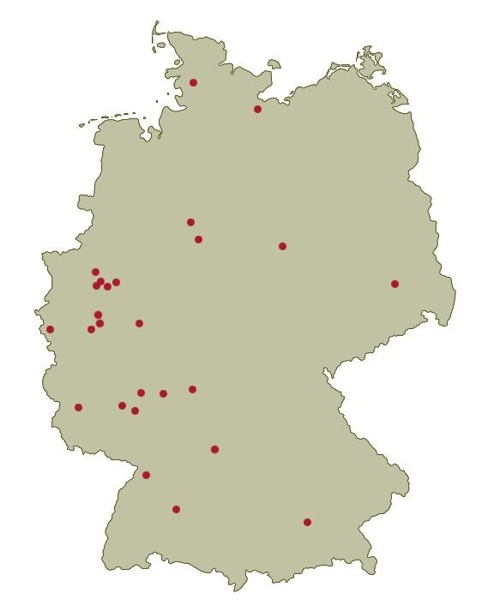
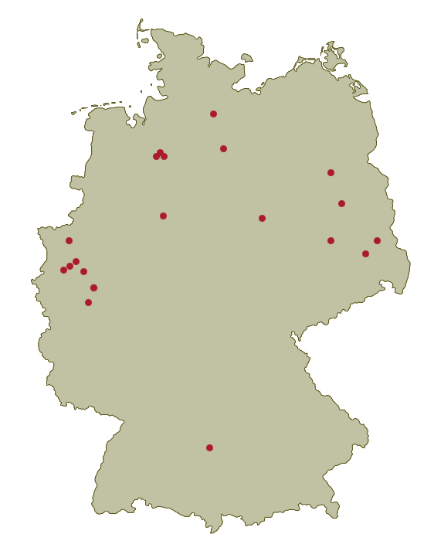
German Portfolio Comparison
Portfolio 1-3,5 & 6 locations
Portfolio 4 locations
32

Slide 33



German Portfolio Comparison
Portfolios 1-3,5 & 6 are 75% anchored by food retailers with strong covenants compared to only 28% in portfolio 4
Portfolio 1-3,5 & 6 tenants
Portfolio 4 tenants
33

Slide 34
Forward Looking Statement
This document contains certain statements that are neither reported financial results nor other historical information. These statements are forward-looking in nature and are subject to risks and uncertainties.
Actual future results may differ materially from those expressed in or implied by these statements. Many of these risks and uncertainties relate to factors that are beyond the Group’s ability to control or estimate precisely, such as future market conditions, currency fluctuations, the behaviour of other market participants, the actions of government regulators and other risk factors such as the Group’s ability to continue to obtain financing to meet its liquidity needs, changes in the political, social and regulatory framework in which the Group operates or in economic or technological trends or conditions, including inflation and consumer confidence, on a global, regional or national basis.
Readers are cautioned not to place undue reliance on these forward-looking statements, which apply only as of the date of this document. The Group does not undertake any obligation to publicly release any revisions to these forward-looking statements to reflect events or circumstances after the date of this document. Information contained in this document relating to the Group should not be relied upon as a guide to future performance.
34

